Slide 1
New Season Products
Lorraine Shaw Communications Manager

Slide 2
Chilli Meals
Chilli Meals™ combine the best home-cooked flavours with total ease of preparation for you and your staff
For our new meals, we've been inspired by the freshness and simplicity of Mediterranean cooking

Slide 3
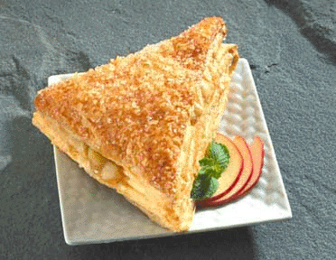
New Additions
Brunch Tart
Chicken and Garlic Pasta
Ham and Onion Cream Tart
Tomato, Basil and Garlic Tart

Slide 4
Offer
Three-for-Two Introductory Offer
Available to the first 100 customers to place an order in December 2000

Slide 5
Product Details
Chicken and Garlic Pasta | 12x330 gms | £21.45
Brunch Tart | 8x | £13.80
Ham and Onion Cream Tart | 8x | £14.00
Tomato, Basil and Garlic Tart | 8x | £11.80

Slide 6
Order Information
If you don't already have a Customer Account with us, to order:
Simply phone 0800 540 540 to speak to a Sales Advisor
Buy online at our website www.joechillis.com

